Slide 1
Credit Card Fraud Detection Random Forest Model
Scott Lucier

Slide 2

Outline
Background On Credit Card Fraud
Dataset And Features Of Data
Model Assumptions
Introduction To Prediction Trees
Random Forests/Bagging
Overview Of Model Building Process
Overview of Model Evaluation Process
Comparison Model
Final Tweaks
Results

Slide 3


Background
Credit card fraud is a persistent issue in the modern world, affecting hundreds of thousands of people and countless dollars each year.
Cards are lost, stolen, counterfeited, and rarely, intercepted in shipment from the bank.
Thankfully, fraudulent uses have characteristics that can be predicted.

Slide 4
Data
The dataset is the Credit Card Fraud Detection, located on Kaggle.com, covering European transactions over two days during September 2013. Compiled by Université Libre de Bruxelles.
The response variable is a classification, fraud or not fraud. 284,807 transactions, 492 fraudulent -> 0.172% fraudulent. This is a very unbalanced dataset.
There are 30 explanatory variables, but 28 of these have been reduced and anonymized through PCA. The uncensored variables are time and amount.
I won’t cover PCA here, but it’s a commonly used anonymization and simplification method.

Slide 5
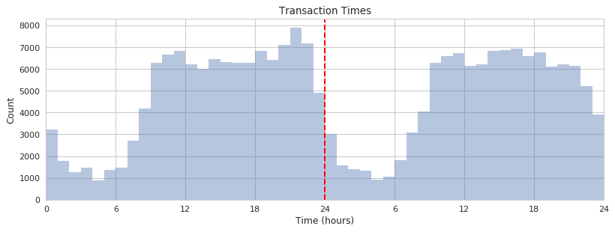
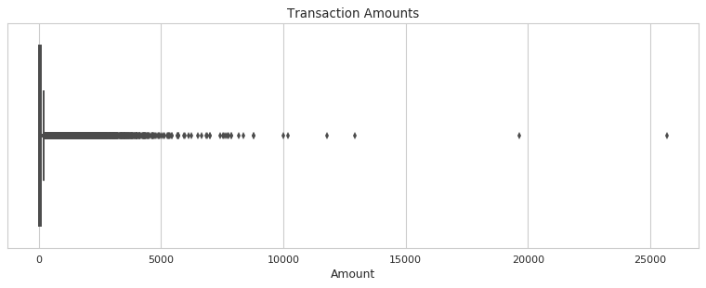
Transaction Time and Amount

Slide 6
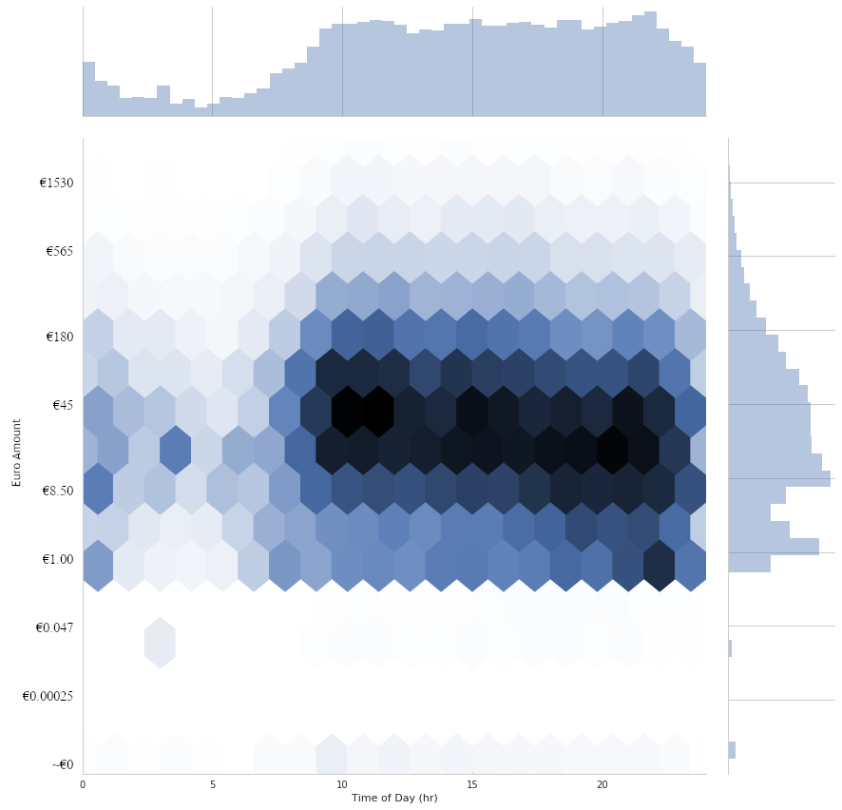
Transaction Hex Chart
Data transformed with Box-Cox for graphability.
Darker hexes means more transactions at that amount-time intersection.
Clear patterns of certain sized transactions are certain times of day.
Graph cuts off at around 3000 Euros – the vast majority of transactions are below this.

Slide 7
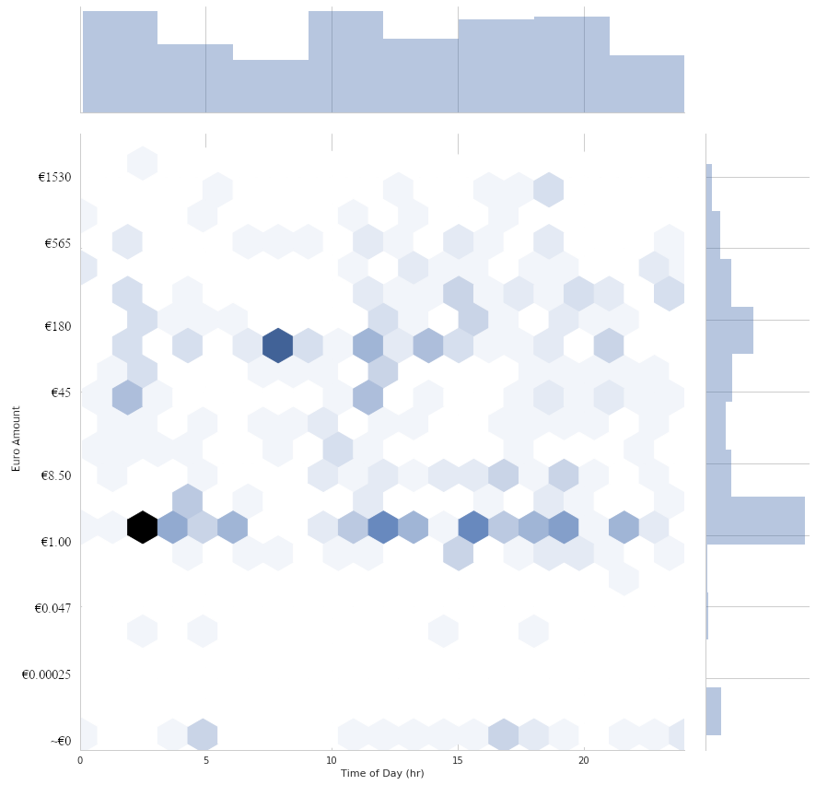
Fraudulent Transactions Hex Chart
Same hex chart, but only fraudulent transactions included.
Certain time-amount combos stand out. Were these individual fraud operations? It’s possible.
Transactions of about a dollar are common.
Perhaps a method of blending in – low amount, but not in a way that stands out.

Slide 8
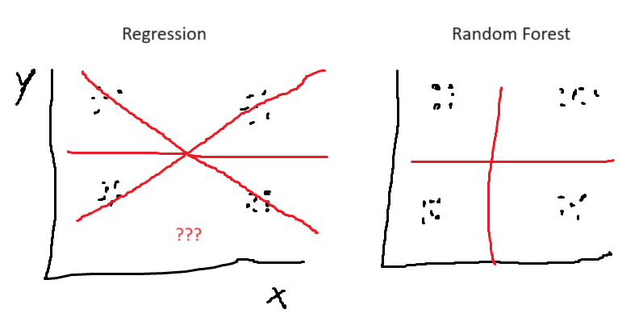
Model Assumptions
Effectively none. Multicollinearity, heteroscedasticity, Non-normality, it doesn’t matter. You just need data. Categorical explanatory variables are hard to work with, but thankfully our dataset doesn’t have any.
However, the more data you have, the more precise the predictions – the model splits up the given data into groups, so more data = more groups = more precision.
This diagram illustrates why that is – there’s no need to “draw a line” like there is with regression. Instead, the data is directly proportioned into “boxes” that don’t really rely on any underlying structure in the data.

Slide 9
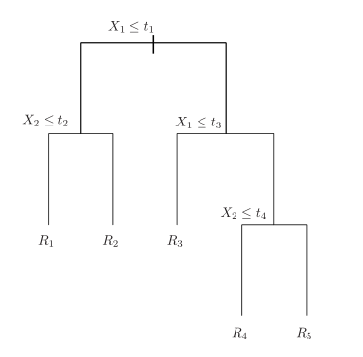

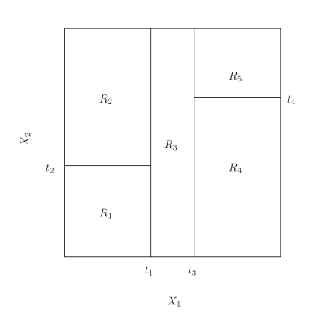
Prediction Trees
RSS =
Recursive splits of predictor space – boxes within boxes
Top down and greedy – each split considers current split only, not future ones.
Split for lowest RSS among possible splits (computer checks)
Generalizes to more than two dimensions/factors.

Slide 10
Random Forests
Bagging is what makes a decision of tree into a forest. We average out the results of multiple decision trees into one greater whole.
We effectively do the entire tree building process several times, but each tree only uses part of the training data – typically, two thirds.
We can even evaluate for accuracy, going through each observation in the training data and testing it on each tree that didn’t include it. Those can be averaged out and combined into an MSE much like standard linear regression
To turn our forest into a “random” forest, we add an additional tweak – randomly selecting which explanatory variables for each split in the tree.
Each variable's importance can be measured by how much RSS decreases due to splits from it, averaged over all the trees in the model – though this model is more focused on overall predictive power than understanding specific factors.

Slide 11
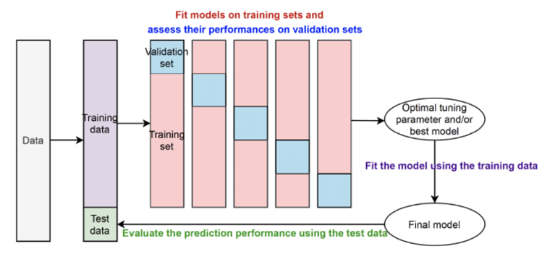
Model Building Process
We will use stratified 5-fold cross validation (CV) to find the optimal model and tune hyperparameters in our model.

Slide 12
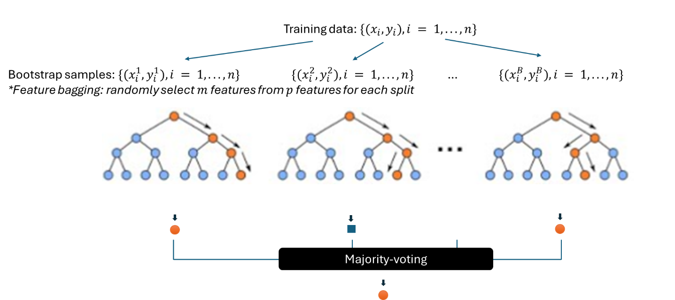
Model Evaluation Process
To test a data point, it’s fed into each of the several hundred trees in the model.
Each tree “votes” on what the result is.
The overall result is the majority vote, for a categorical output, or an average for a numerical one.

Slide 13
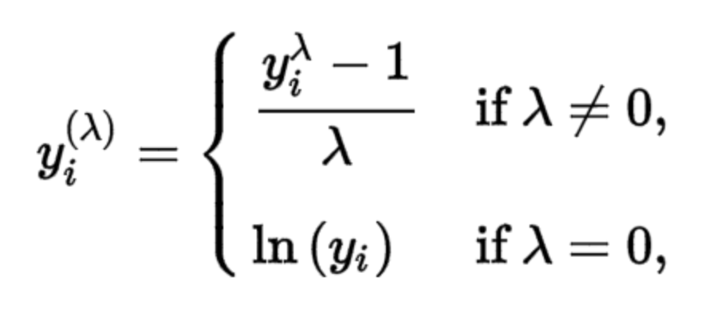
Comparison Model
As a point of comparison, I’ve used a well known and simpler model - logistic regression.
For skewness reasons, the Euro amount variable is normalized using the box-cox transformation.
The Box-Cox transformation is the advanced version of using a log transformation for normality – the log transformation is actually a special case of it.
Tunning parameter lambda (λ) is tested between values -5 and 5, and the value that results in a distribution most close to a normal distribution is selected.
We use .134 as the value of lambda.

Slide 14
Final Tweaks
I Tried a few methods to deal with the imbalanced dataset, training a model with each tweak.
Undersampling worked best, marginally better than without.
This simply drops data from the training data until a specified fraud to not-fraud ratio is reached. In this case, a 1% fraudulent transactions worked best.
As an experiment, I tried normalizing the amount data with the Box-Cox transformation to see if this would increase robustness to inflation and similar changes.
I changed the test data to an inflated version of the original – just increasing all Euro entries by a few percentage points. Smaller transactions possibly don’t inflate year to year, but are also increased by a miniscule amount that probably doesn’t matter.
Ultimately this didn’t increase model performance at all, which is somewhat surprising.

Slide 15
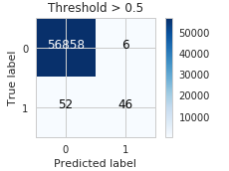
Results - Logistic Regression
Precision = .88
Precision = Proportion of predicted frauds that are actually frauds. In this case, 46 out of 52.
Recall = .47
Recall = Proportion of frauds detected as such.
Only finds 46 of the 98 frauds.
This can be increased by lowering the threshold, but this leaves the model extremely fragile – it’s a form of overfitting.
Final logistic regression model selected using stratified 5-fold cross validation out of many possible similar models:
l2 penalty
Coefficient of penalty term: 0.002592943797404667
Performance metrics used for training: area under the precision-recall curve (“average” precision for different thresholds)

Slide 16
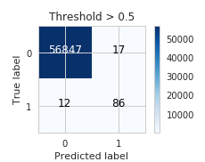
Results - Random Forest with Undersampling
Precision = .83
Recall = 0.88
86 out of 98 frauds detected
Recall is our main metric for fraud detection.
Final random forest model selected using stratified 5-fold cross validation out of many possible similar models:
‘max_depth': None,
'max_features': 5,
'min_samples_leaf': 1,
'min_samples_split': 2,
'n_estimators’: 500
Undersampling ratio: 0.01

Slide 17
References
Credit Card Fraud Detection Dataset
Reproducible Machine Learning for Credit Card Fraud detection - Practical handbook
An Introduction to Statistical Learning with applications in Python, by Gareth James et. al.

